Slide 1
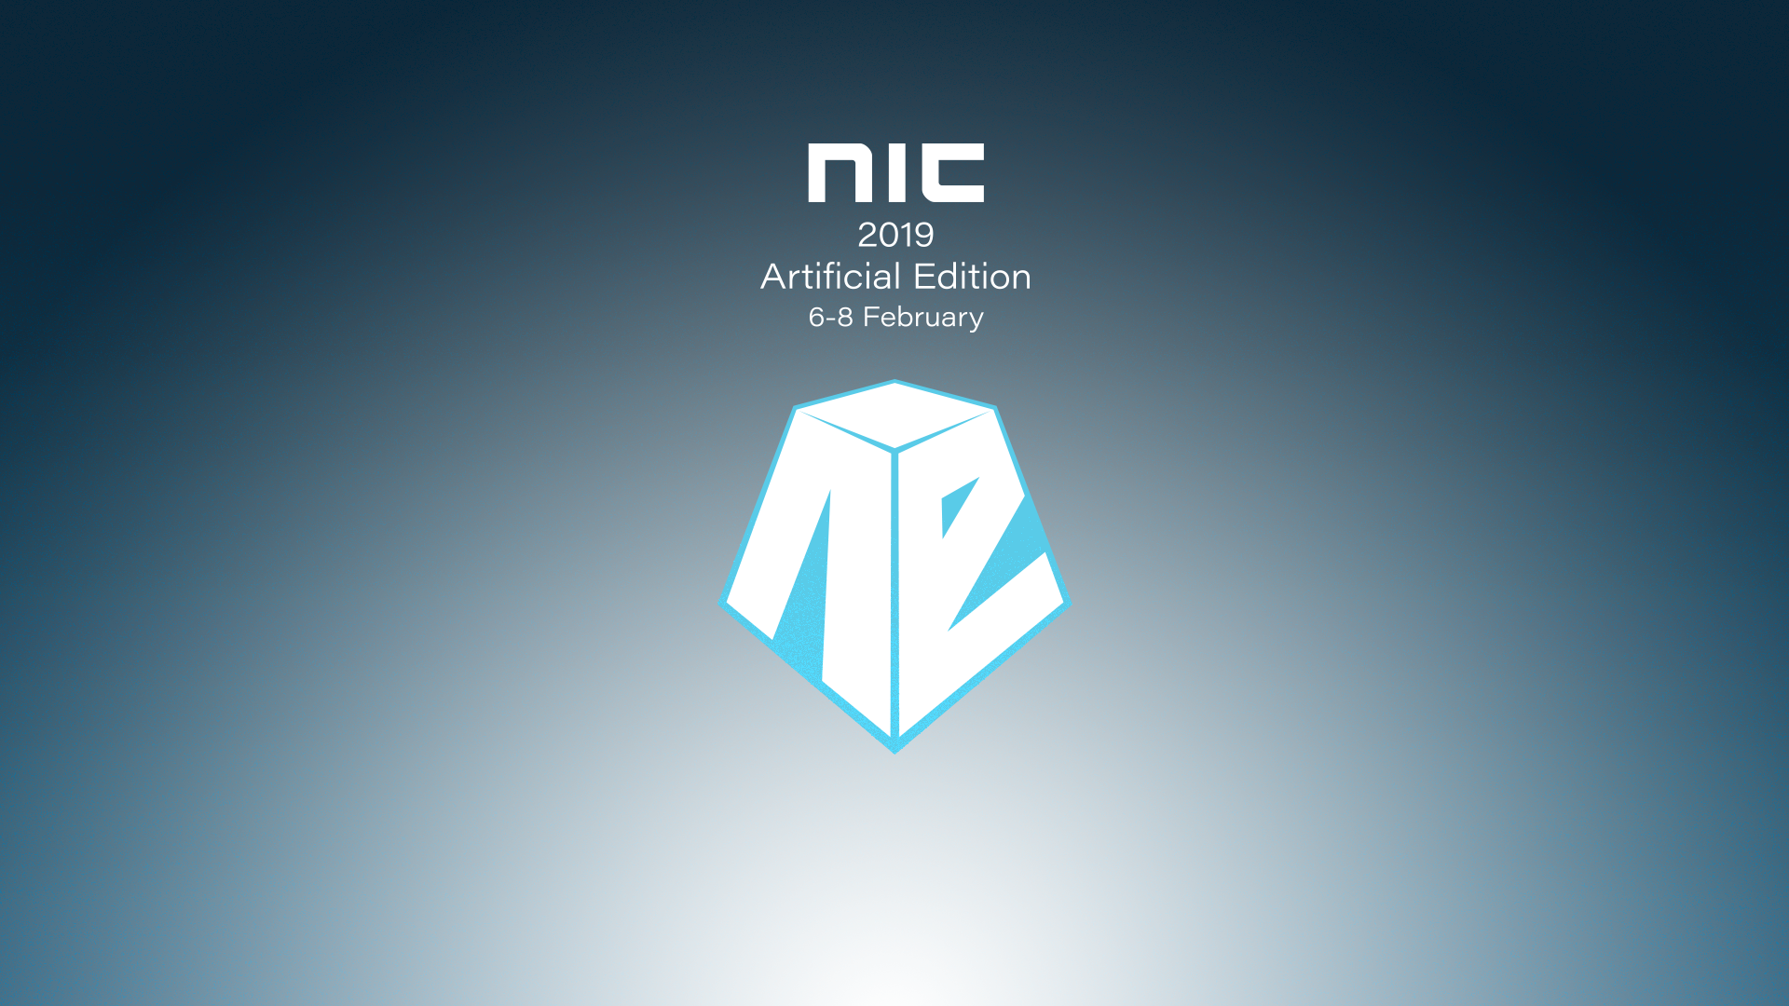

Slide 2
Better Hybrid Security using Cloud App Security
Peter Schmidt (MVP, MCM)
@petsch

Slide 3


About me...
Peter Schmidt
Freelance Cloud Architect
NeoConsulting
Microsoft MVP: Office Apps & Services (11 years)
Founder: CoLabora User Group Denmark
MCM & MCSM: Exchange
Contact Me
Twitter: @petsch
Blog: https://www.msdigest.net/
Mail: peter@neoconsulting.dk
Phone: +45 2080 9436

Slide 4
Agenda
Intro
Microsoft Cloud App Security
Demo
Hybrid Security
Demo

Slide 5
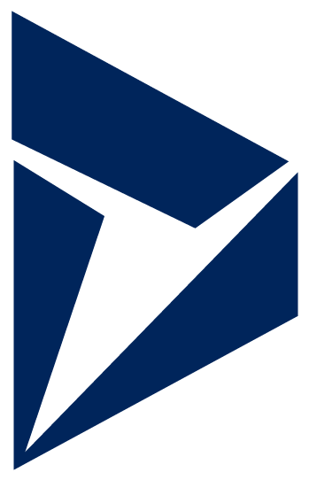


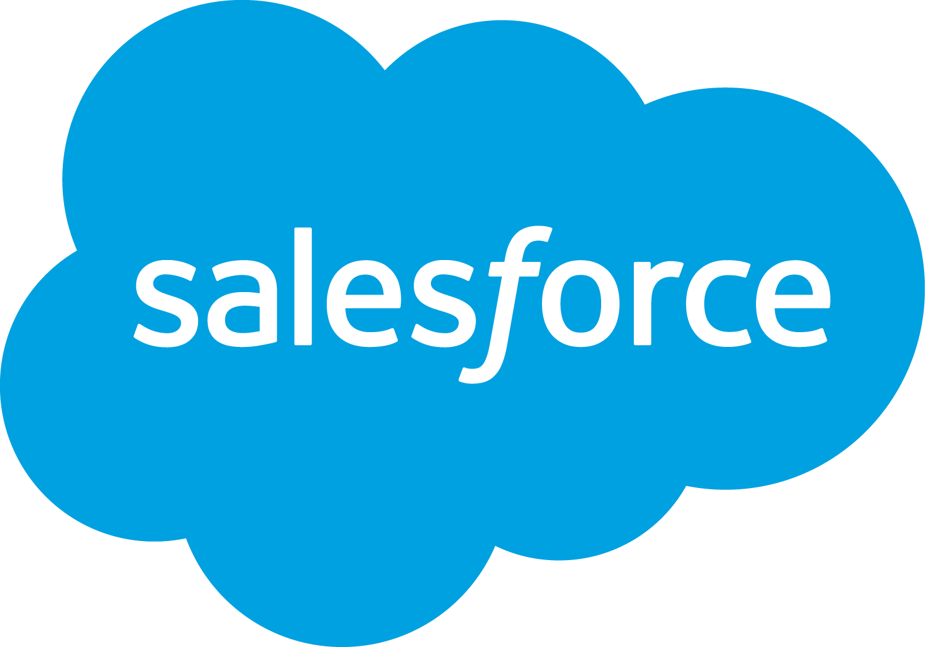




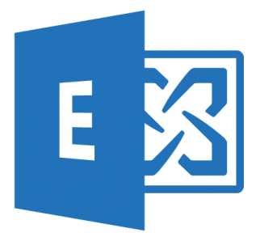



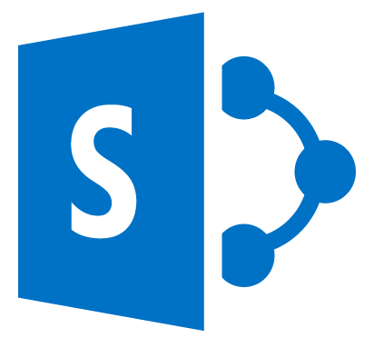


CLOUD SERVICES ARE KEY TO TODAY’S IT STRATEGIES
1,181
75%
different cloud services are used by enterprises on average
of companies consider SaaS tools essentials to their business
61%
80%
of cloud applications IT isn’t aware of
of workers use non-sanctioned cloud apps

Slide 6
CLOUD ACCESS SECURITY BROKERS
By
Cloud Access Security Brokers (CASBs) are defined by Gartner as:
On-premises, or cloud-based security policy enforcement points, placed between cloud service consumers and cloud service providers to combine and interject enterprise security polices as the cloud-based resources are accessed. CASBs consolidate multiple types of security policy enforcement.
2020
85%
of large enterprises will use CASBs

Slide 7



TOP MCAS USE CASES
Box
YouTube
Twitter
Office 365
AWS
Facebook
Dropbox
Salesforce
Azure
Unsanctioned apps
Sanctioned apps
Cloud Threats
Classify, label and protect sensitive information
Identify and mitigate malware activities
Assess if your cloud apps meet compliance
Discover the cloud apps
Govern discovered apps
Control and monitor user sessions in real-time
Detect insider threats and compromised accounts
Corporate HQ
Public/Home Wi-Fi
External Users
Unmanaged Devices

Slide 8
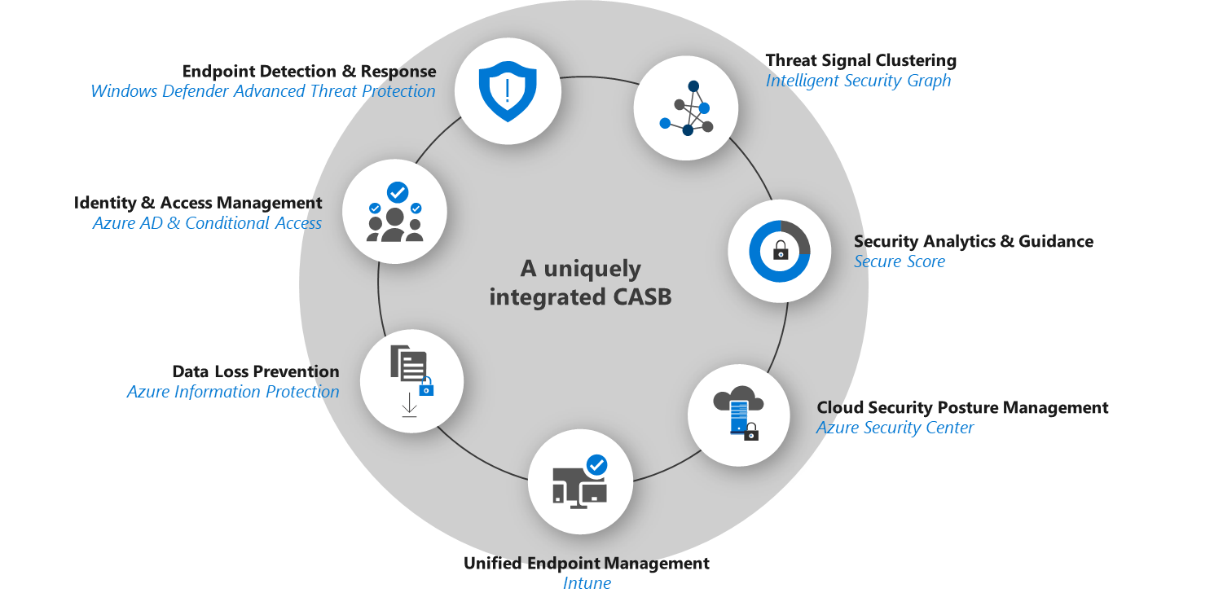
MICROSOFT CLOUD APP SECURITY
Natively integrated with Microsoft 365 and beyond

Slide 9













CLOUD APP SECURITY IN THE MARKETPLACE
Featured 3rd party apps

Slide 10
Discovery Lifecycle
Safely adopting cloud apps
Continuous monitoring
Be alerted when new, risky or high volume apps are discovered in your environment for continuous monitoring and ongoing control over your cloud apps.
Discover Shadow IT
Identify which apps are being used in your organization.
Phase 3
Phase 1
Phase 2
Evaluate and Analyze
Discover and Identify
Manage and
Continuous monitoring
Manage cloud apps
Start managing cloud apps and leverage one of several governance actions such as Sanction, Unsanction, onboarding an app to AAD to leverage SSO, marking them for review or blocking them from your network.
Identify the risk levels of your apps
Understand the risk associated with discovered apps, based on more than 70 risk factors including, Security factors, industry- and legal regulations.
Analyze usage
Understand the usage patterns and identify high risk volume users.
Evaluate compliance
Evaluate whether the discovered apps meet the compliance standards of your organization against factors like GDPR or industry-relevant standards like HIPAA readiness.

Slide 11
MCAS Key Features
Cloud app catalog
with details and signatures for more than 16,000 of cloud apps
Risk assessment
by specialists inspecting more than 70 attributes including compliance industry standards, security features and posture, and terms of service
Usage analytics including number of apps, traffic pattern, users and machines usage patterns Dashboards and reporting
visual summary of key usage statistics, executive reports, pre-built and custom queries
Policies and alerts
customized based cloud app's risk, characteristics and usage pattern
Anomaly detection
of suspicious cloud usage that deviates from the normal pattern
Access control to unsanctioned apps
using native integration with leading proxies and programmatic block scripts
Flexible agent less deployment mode
though the console, on premise log collector, and native integration with proxies and Windows Defender ATP
App management
with pre-built and customizable app tags
Automated workflows SIEM integration for centralized monitoring of alerts, and custom workflows

Slide 12






Architecture and how it works
Discovery
Use traffic logs to discover and analyze which cloud apps are in use
Manually or automatically upload log files for analysis from your firewalls and proxies
Sanctioning and un-sanctioning
Sanction or block apps in your organization using the cloud app catalog
App connectors
Leverage APIs provided by various cloud app providers
Connect an app and extend protection by authorizing access to the app. Cloud App Security queries the app for activity logs and scans data, accounts, and cloud content
Cloud apps
Cloud App Security
API
App connectors
Protected
Cloud discovery
Cloud traffic
Firewalls
Cloud traffic logs
Proxies
Your organization from any location

Slide 13
Cloud App Security Flavours
Cross-SaaS security
Office 365 security
 | Microsoft Cloud App Security | Office 365 Advanced Security Management
App discovery | Discovers 16,000+ apps and provides an automated risk score Provides ongoing risk assessment for discovered services (usage patterns, upload/download traffic anomalies) Anomaly detection for discovered apps Manual or automatic log upload | Discovers apps that have similar functionality to Office 365 Manual log upload
Data control | Policy setting and enforcement DLP and data sharing controls all sanctioned apps (cross-SaaS) Identify and control apps connected to supported cloud services with the ability to revoke access Use Azure AD Premium for user and session access control, SAML proxy for non-Azure AD customers for any app | Use existing Office DLP (available in E3 and above) Use Azure AD Premium for user and session access control Identify and control apps connected to Office 365 with the ability to revoke access
Threat prevention | Alerts dashboard includes all policy violations, threat detection, and anomaly detection across SaaS apps Manual or automatic alert remediation | Anomaly detection and security alerts for Office 365 Manual and automatic alert remediation

Slide 14
Microsoft Cloud App Security licensing options
EMS E5
Microsoft CAS
CASB for any cloud app
Office 365 E5
Office 365 CAS
CASB for Office 365
AAD P1 (EMS E3)
CAS Discovery
Discovery of Shadow IT

Slide 15
The Security Challenges

Slide 16




Todays Security Challenge ?
What data are users sharing with external
Use of personal Apps or non-approved Cloud services
Data in multiple sources (clouds and on-premise)
What is a certain App actually doing?
Compliance Issues (GDPR / DLP)
Security Issues (Malware / Data leak)
Missing overview

Slide 17






Questions to answer
Access control
Shadow IT
Employee downloads customer details from an airport kiosk.
How can I detect and limit access?
Office 365 is rolled out. How do I know which groups are using other apps?
Threat prevention
Data protection
How do I know if my users have been breached?
An employee publicly shares a sensitive file in the cloud.
How can I detect that?

Slide 18
PROTECTING FROM CLOUD THREATS
Malicious Insider
Protect against disgruntled employees before they cause damage
Rogue Application
Identify rouge applications that access your data
Malware
Detect malware in cloud storage as soon as it’s uploaded
Data exfiltration
Detect unusual flow of data outside of your organization
Ransomware
Identify ransomware using sophisticated behavioral analytics technology
Compromised Accounts
Combat advanced attackers that leverage compromised user credentials

Slide 19


Microsoft Cloud App Security – Detections across apps
Malware implanted in cloud apps
Malicious OAuth application
Multiple failed login attempts to app
Suspicious inbox rules (delete, forward)
Unusual file share activity
Unusual file download
Unusual file deletion activity
Ransomware activity
Data exfiltration to unsanctioned apps
Activity by a terminated employee
Indicators of a
compromised session
Malicious use of
a privileged user
!
!
!
Threat delivery
and persistence
Malicious use of
an end-user account
Activity from suspicious IP addresses
Activity from anonymous IP addresses
Activity from an infrequent country
Impossible travel between sessions
Logon attempt from a suspicious user agent
Unusual impersonated activity
Unusual administrative activity
Unusual multiple delete VM activity

Slide 20

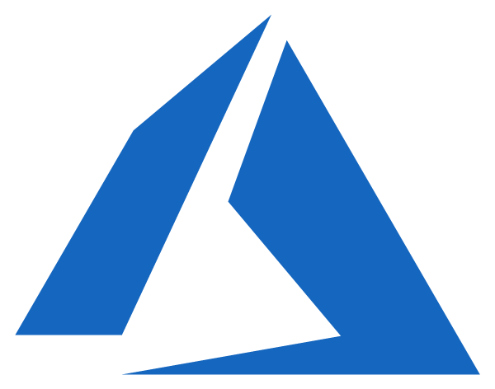
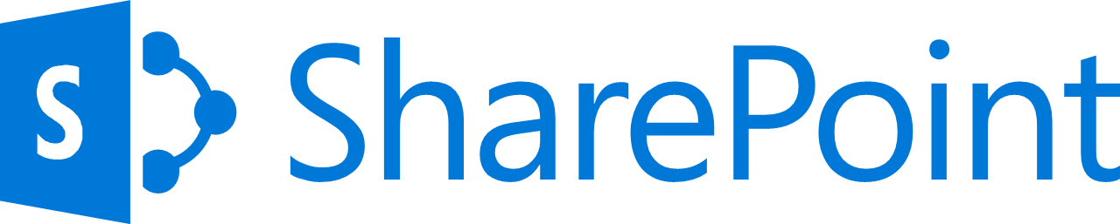
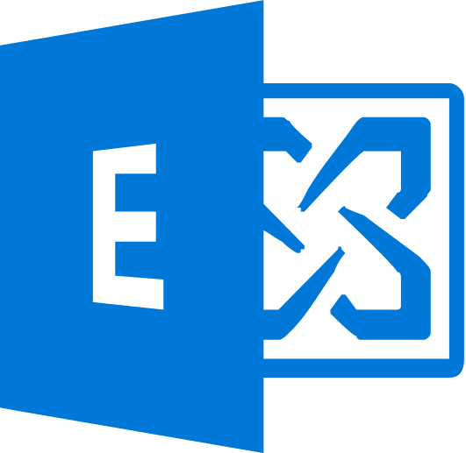



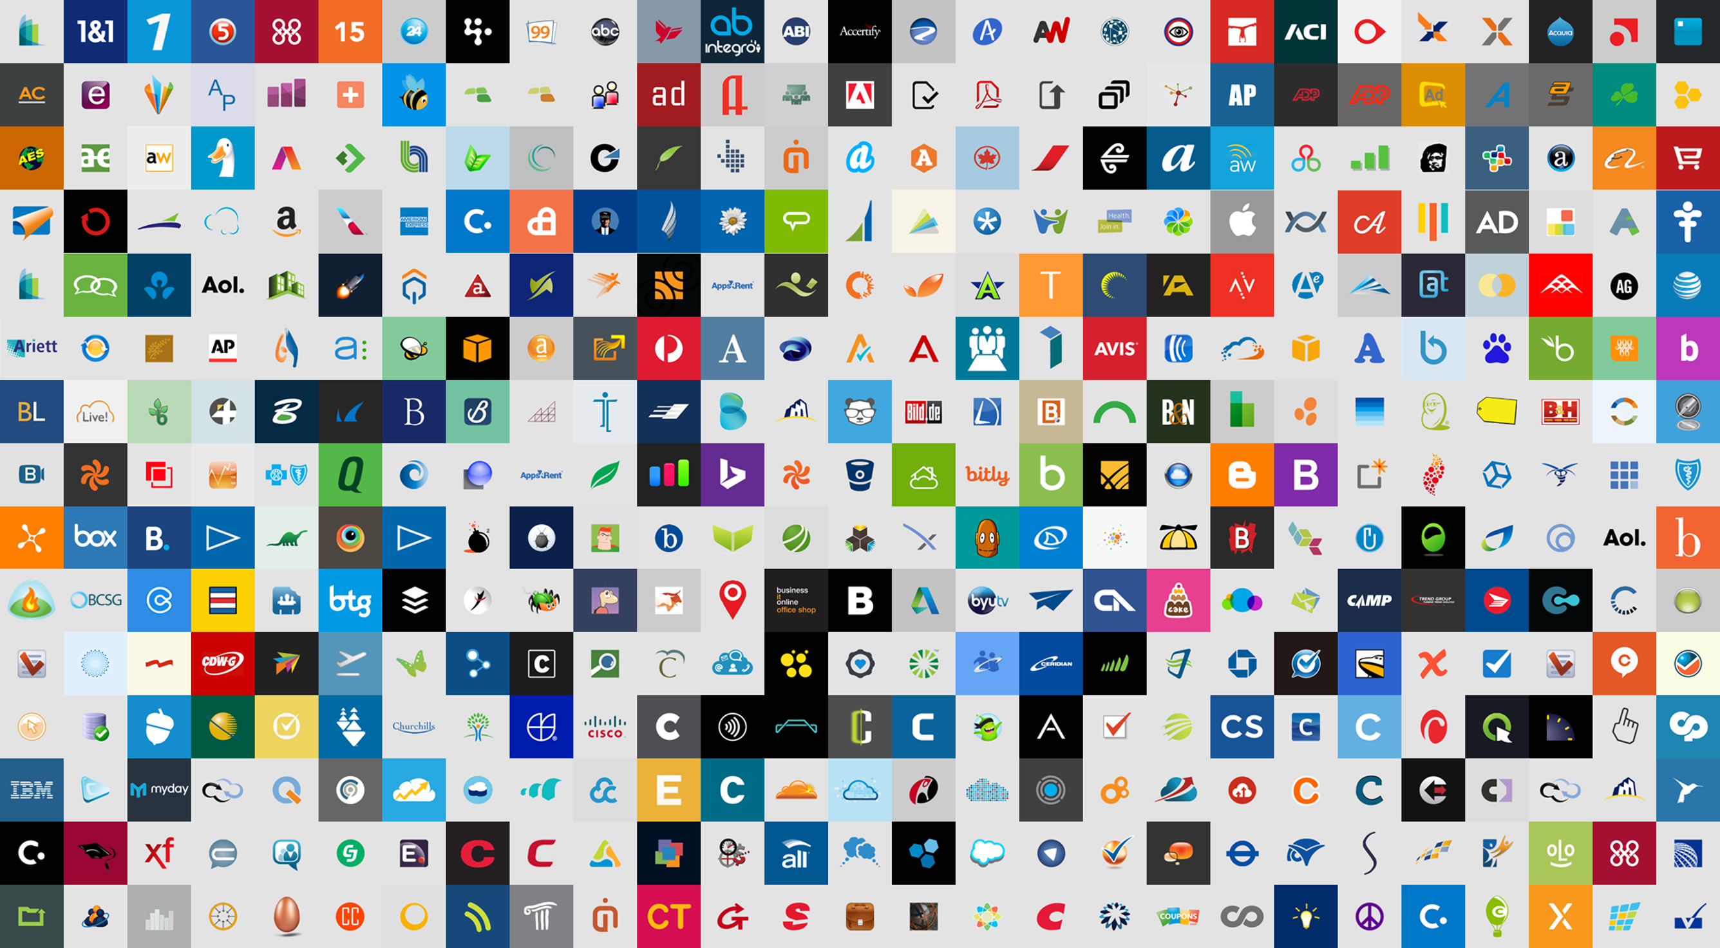


MCAS
Azure AD
ADFS
Conditions
Controls
MSA
40TB
Google ID
Employee & Partner Users and Roles
Allow/block
access
Microsoft Cloud
Android
Session Risk
iOS
Machine learning
3
Microsoft Cloud App Security
MacOS
Trusted & Compliant Devices
Limited
access
Windows
Windows Defender ATP
Real time Evaluation
Engine
Require
MFA
Cloud SaaS apps
Geo-location
Location
Force
password
reset
Corporate Network
******
Policies
Effective policy
Client apps & Auth Method
Terms of Use
Browser apps
Client apps
On-premises apps

Slide 21
Microsoft Cloud App Security
Discover and assess risks
Control access in real time
Protect your information
Detect threats
10101010101010101010101010101011010
10101
Identify cloud apps on your network, gain visibility into shadow IT, and get risk assessments and ongoing analytics.
Manage and limit cloud app access based on conditions and session context, including user identity, device, and location.
Get granular control over data and use built-in or custom policies for data sharing and data loss prevention.
Identify high-risk usage and detect unusual behavior using Microsoft threat intelligence and research.

Slide 22

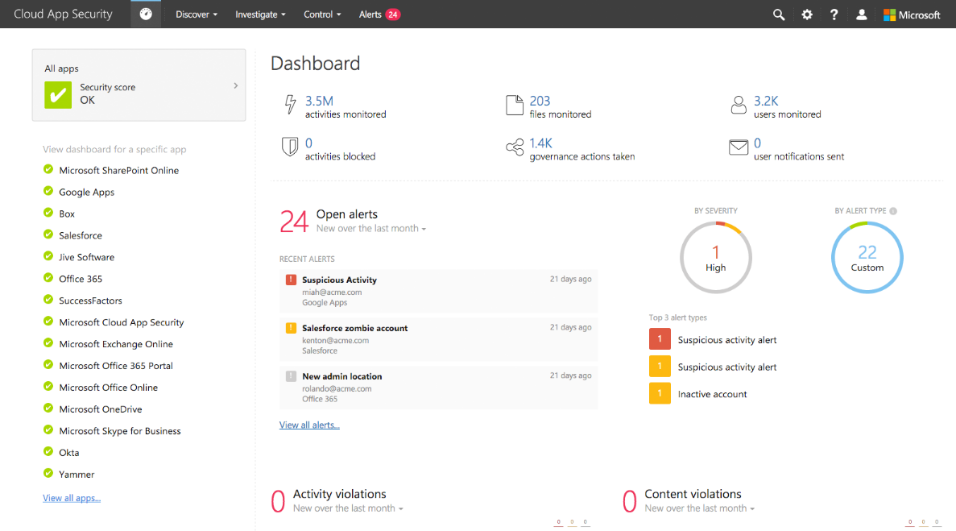
Cloud App Security

Slide 23
Hybrid Security

Slide 24
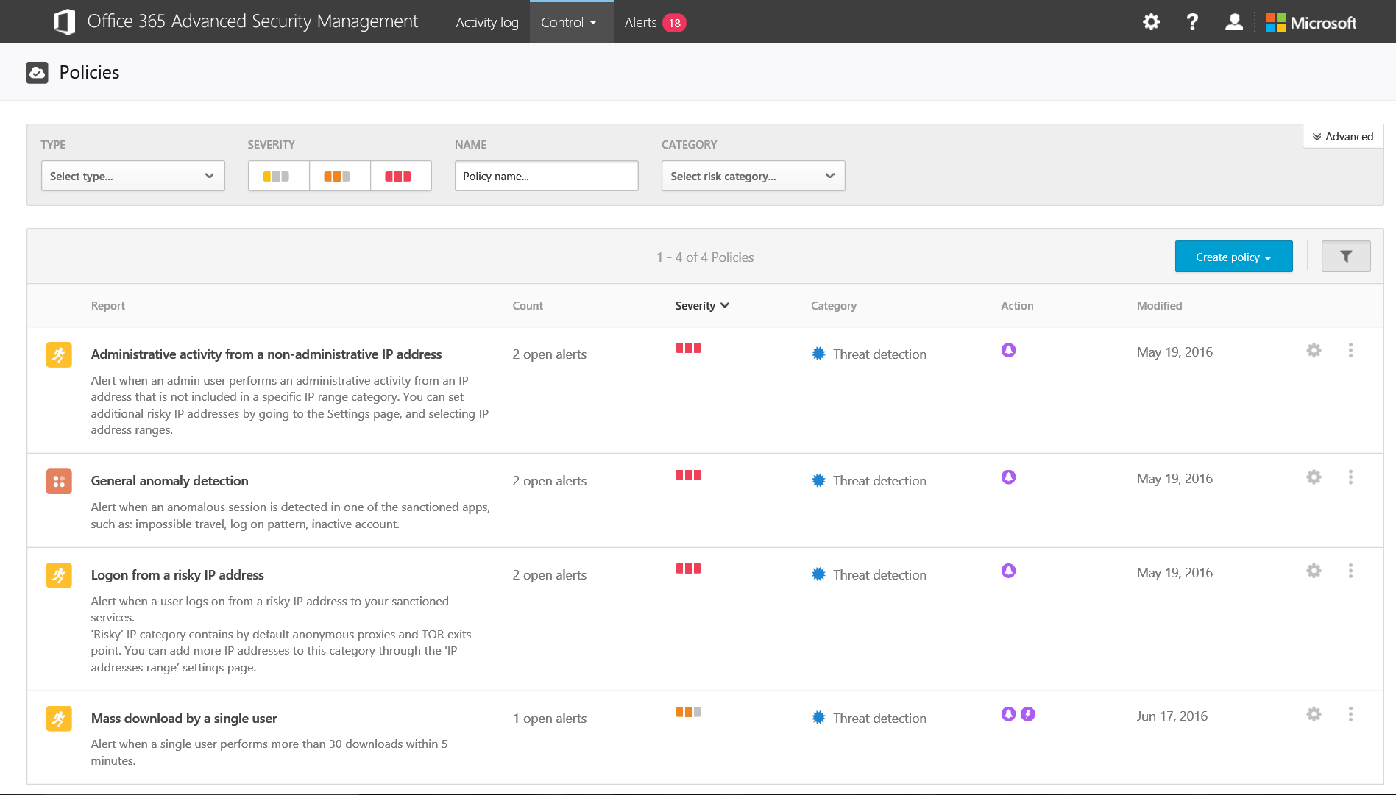
Discovery architecture
Azure
On-premise network
Microsoft Cloud App Security
Syslog CEF
Network logs
Log collector
Log parser
Syslog
Log analysis (SaaS DB)
SaaS DB
FTP
FTP
Discovery dashboard and alerts
Discovery aggregations
Tenant DB
Firewall
Web proxy
Firewall
Firewall
Cloud apps

Slide 25
Upload discovery logs – Continuous upload
Navigate to “cloud discovery settings” under settings
Choose “Upload logs automatically”
Create a data source.
Create a log collector.
Configure the firewall/proxy to send logs to the specified port
Validate deployment by reviewing the governance log
Download the log collector and run it.
Connect to the server via SSH
Run the collector_config tool

Slide 26
Hybrid Scenarios
Windows Defender ATP
Cloud App Security Log Collector
Automate log uploads
Docker images
Ubuntu
RHEL
Azure
Vmware / Hyper-V

Slide 27
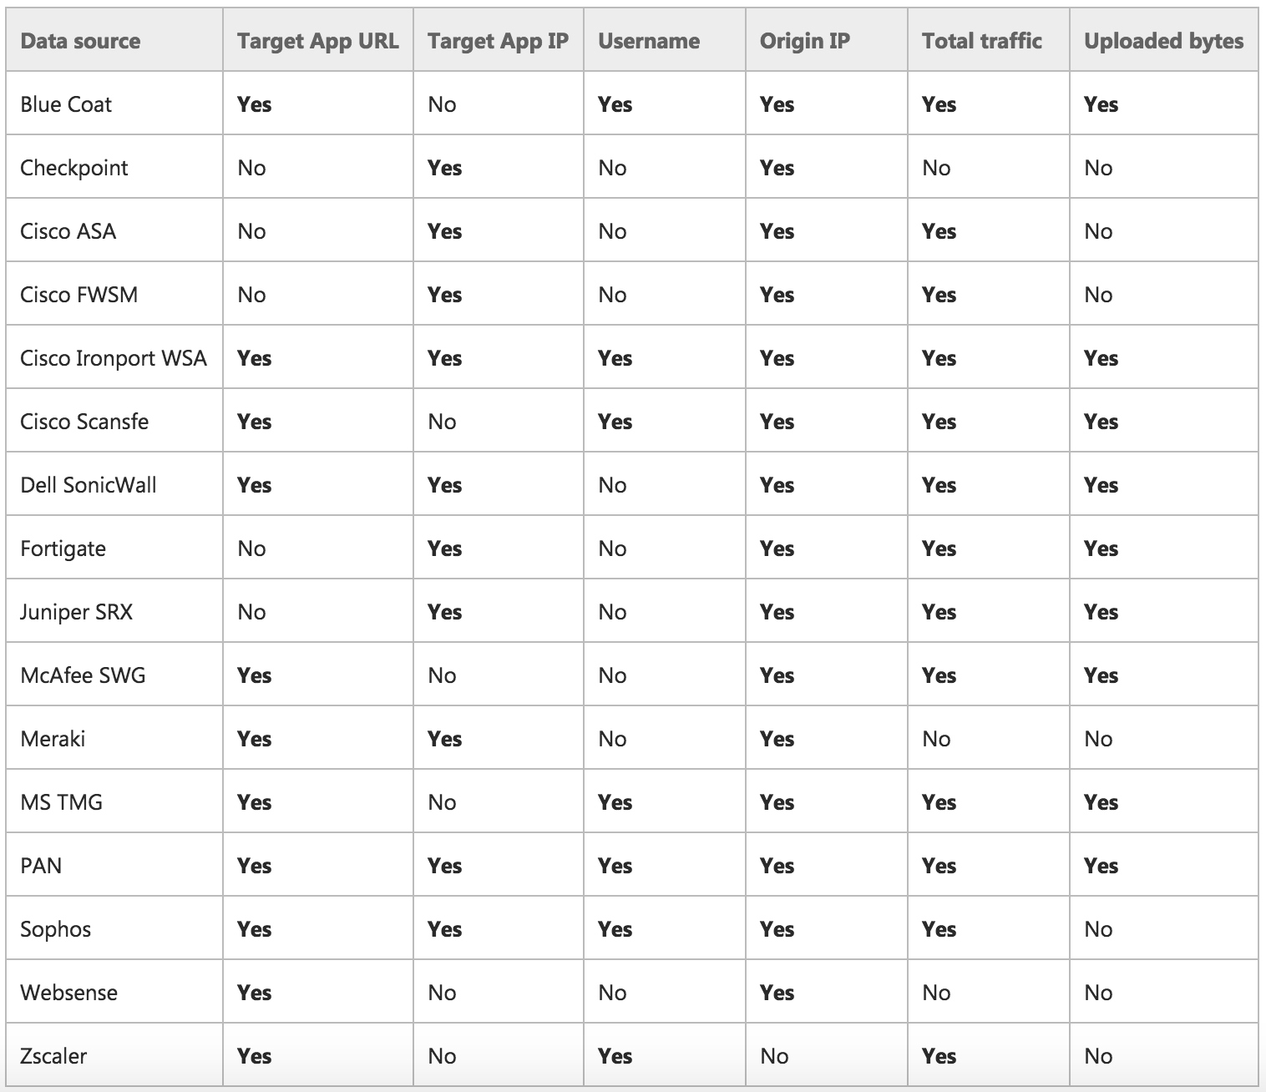
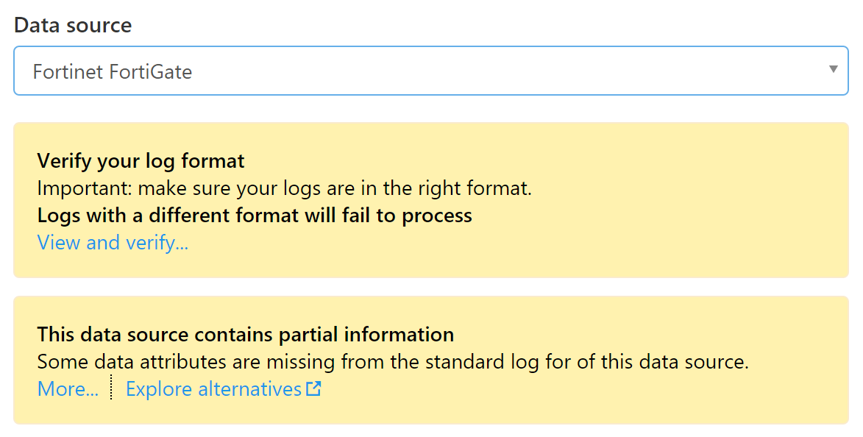
Log Format Compatibility
Network traffic logs include a notification/ disclaimer that explains if there is missing data in the chosen format.

Slide 28
Cloud App Security

Slide 29
Getting Started
Plan and align with your Security Policy’s
If you use Intune you need to use Cloud App Security
Create Good Test Scenarios
Use solution as part of an overall Security plan
Cloud App Security helps take your organization from a reactive to a Pro-Active Cloud Security environment
Cloud App Security is included in E5

Slide 30
References
MCAS Portal: https://www.microsoft.com/en-us/cloud-platform/cloud-app-security-resources
PowerShell Module: https://github.com/Microsoft/MCAS
Get started with a free trial: aka.ms/mcastrial
Learn more about Microsoft Cloud App Security: aka.ms/mcastech
Join the conversation on TechCommunity: aka.ms/mcascommunity
MCAS Blog: aka.ms/mcasblog
MCAS Website: aka.ms/mcas

Slide 31
Key Takeaways
Discover and assess risks
Control access in real time
Protect your information
Detect threats
10101010101010101010101010101011010
10101
Centralized Security Dashboard
Discovery – Get the overview

Slide 32

Thank You!
Do you have any Questions ?
Peter Schmidt
Mail: peter@neoconsulting.dk
Twitter: @petsch
Blog: www.msdigest.net
https://github.com/nordicinfrastructureconference/2019
Remember session evaluation – Thanks !
Dette billede efter Ukendt forfatter er licenseret under CC BY-NC-ND

